Slide 1
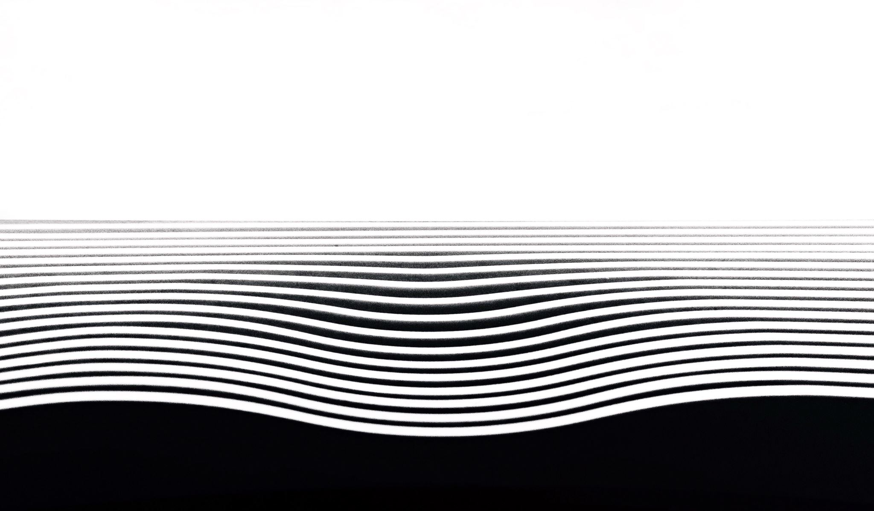
Shedding Some Light on the Light Up Puzzle with AI
James Browning, Robert Perera, and Libo Sun

Slide 2
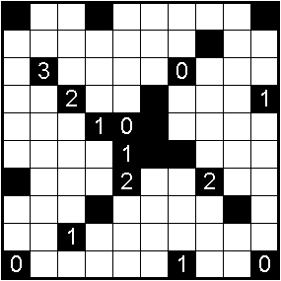
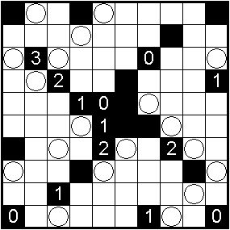
Recap: Problem Definition
The Light Up puzzle involves placing light bulbs into white squares to illuminate the entire board without any overlapping rays.
Black squares can’t be filled, and black squares with numbers inside them must have that number of adjacent bulbs.

Slide 3
Recap: Our Approach
To solve the oft-ignored Light Up puzzle with artificial intelligence, we planned a three-step approach.
First, randomly generate puzzles, then find optimal solutions using hill climbing.
Second, find optimal solutions using simulated annealing.
Third, use the data generated by the hill climbing and simulated annealing algorithms to train a deep neural network.

Slide 4
Our Progress
Since our midterm presentation, we have…
…completed initialization code for randomly generating Light Up puzzles.
…implemented hill climbing and simulated annealing for finding optimal solutions.
…successfully trained a convolutional neural network using the data generated by hill climbing and simulated annealing.
(Note to self: This one might not actually be ready by the time we present. Check in with Robert for a progress report.)

Slide 5
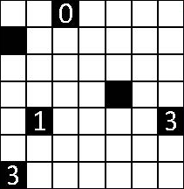
Our Progress
Since our midterm presentation, we have…
…completed initialization code for randomly generating Light Up puzzles (see right for an example of how boards are represented).
…implemented hill climbing and simulated annealing for finding optimal solutions.
…successfully trained a convolutional neural network using the data generated by hill climbing and simulated annealing.
[6,6,0,6,6,6,6], [5,6,6,6,6,6,6], [6,6,6,6,6,6,6], [6,6,6,6,5,6,6], [6,1,6,6,6,6,3], [6,6,6,6,6,6,6], [3,6,6,6,6,6,6]

Slide 6
Results: Hill Climbing
Our work on hill climbing and simulated annealing was divided into three parts:
Vanilla hill climbing with no special puzzle parameters.
Vanilla hill climbing with a puzzle with a single, unique optimal solution.
Simulated annealing with a puzzle with a single, unique optimal solution.
The first of those proved to be the weakest implementation — if the puzzle lacked a single, unique optimal solution, vanilla hill climbing could rarely produce a globally optimal solution.
If there was a single, unique optimal solution, however, vanilla hill climbing could find it — given enough evaluations.

Slide 7
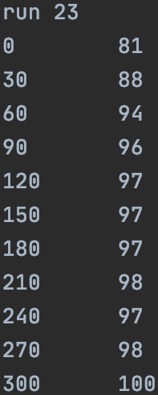
Results: Hill Climbing (Cont.)
To the right, you can see sample results from vanilla hill climbing with an optimized puzzle.
In one trial, at 300 function evaluations, the algorithm was able to find a globally optimal solution.
This particular run was not representative of all runs with these parameters, however, which often required thousands of evaluations.

Slide 8
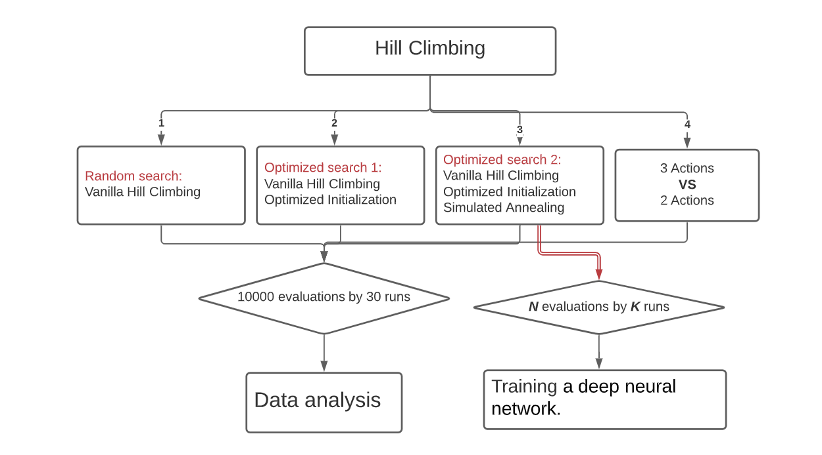

Slide 9
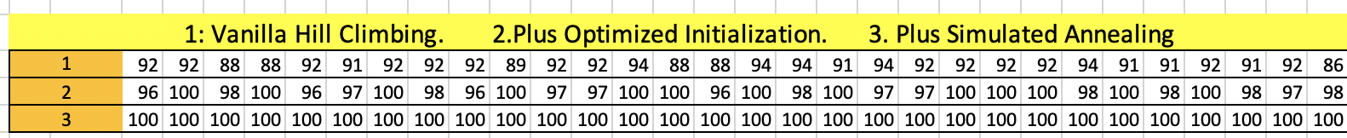
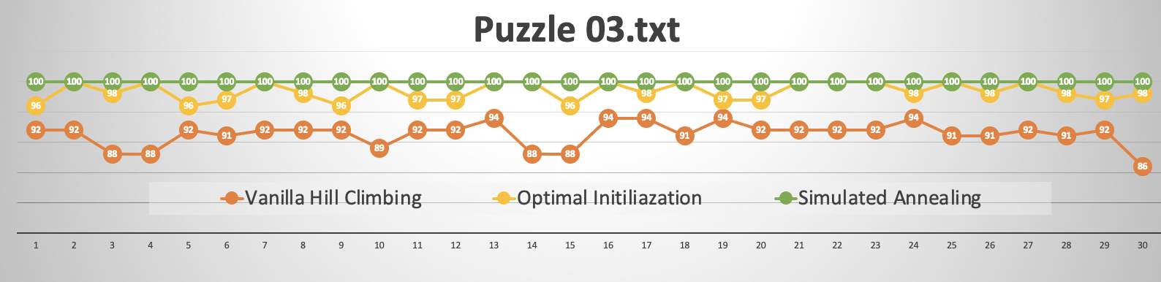
1. Vanilla Hill Climbing 2. Optimized initialization 3. Simulated Annealing
Puzzle: 03.txt
Logs: 01_03.txt
02_03.txt 03_03.txt

Slide 10
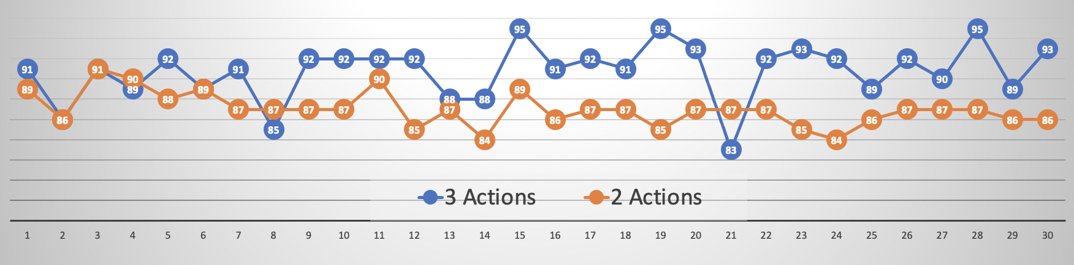
3 Actions VS 2 Action
Puzzle: 05.txt
Logs: 03_05.txt 3-actions
04_05.txt 2-actions
2 Actions:
Adding /Removing A bulb
No Moving
3 Actions:
Adding /Removing/Moving A bulb

Slide 11
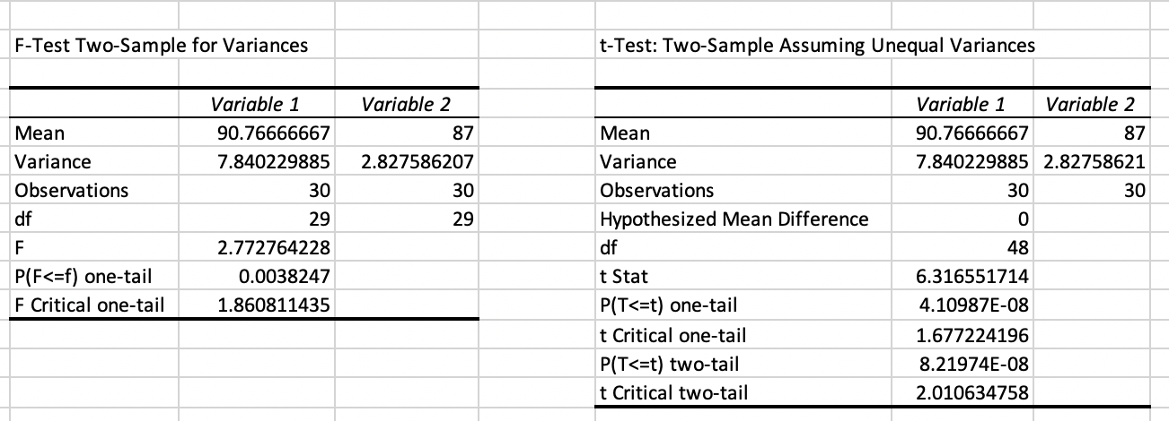
T-Test result
P-Value: 4.11 E-08. Too small to 0.05
Statistically speaking: 3 actions has better performance than 2 actions

Slide 12
Results: Simulated Annealing
Simulated annealing was found to be a much more robust algorithm than vanilla hill climbing, often producing globally optimal solutions in less than one thousand function evaluations.
“Often” does not mean “always,” however, and simulated annealing would still occasionally have trouble — in one instance, 8,700 evaluations were needed to find the global optimum.
This is still an improvement over vanilla hill climbing with the same puzzle parameters, though, which sometimes needed over 10,000 function evaluations to solve a problem of similar complexity.

Slide 13
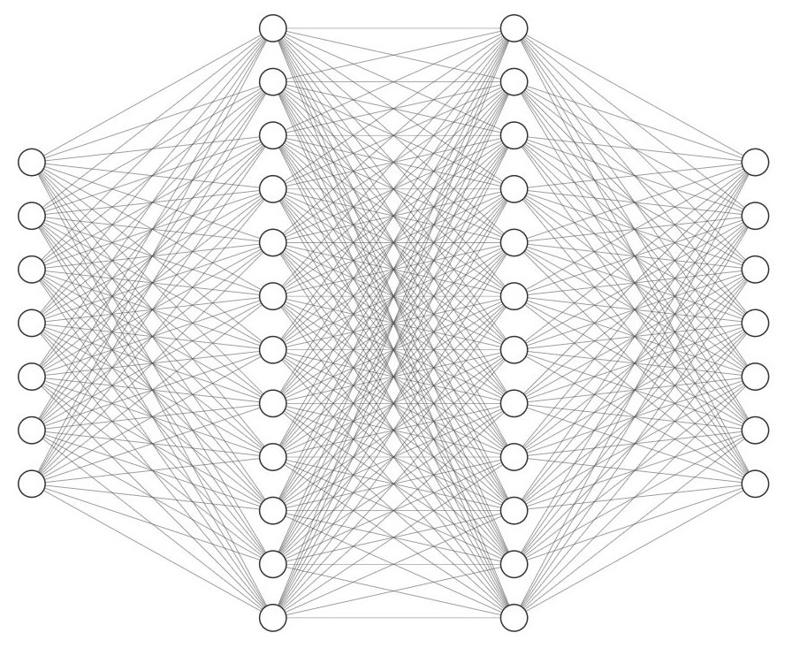
Forward-Feed Neural-Net (FCNN)
Input: 49 Neurons (7x7 Board)
Hidden Layers: 2 Layers (1024 Neurons each)
Activation Functions: ReLU and Softmax
Optimization Function: Stochastic Gradient Descent
Output: 49 Neurons (each neuron corresponds to digit from 0-8)

Slide 14
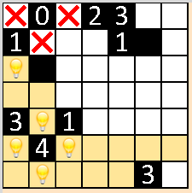
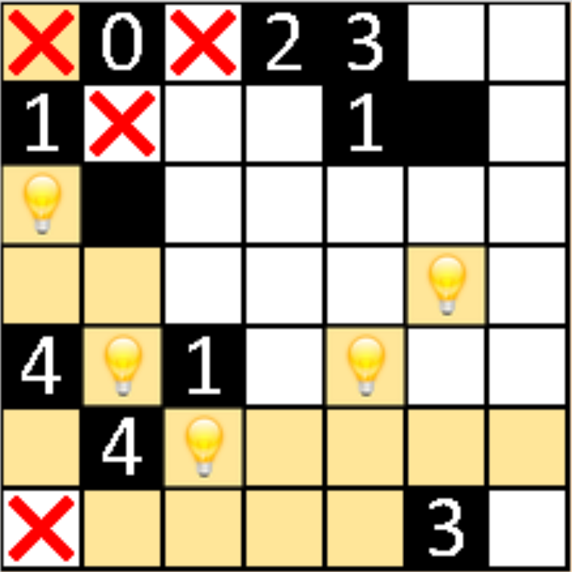
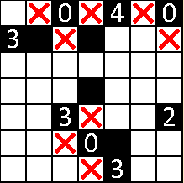
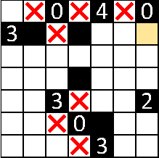
FCNN – Initialization Results
5000 randomly generated boards (1 day)
Train Set: 4000
Test Set: 1000
Errors:
Incorrect Labels
Not enough training data
Not able to capture a general relationship for initialization
Improvements:
Implement Convolutional Neural Nets (CNN)
Gather more data
Original
Predicted
Original
Predicted

Slide 15
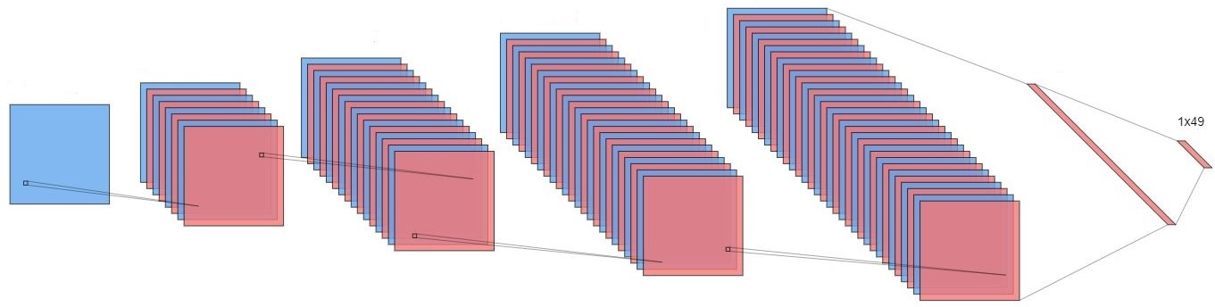
Convolutional Neural-Net (CNN)
Input: 7x7 Board – 1 Channel
Convolution Layers: Four 2D-Convolutions
2DConv1: Filter (5,5), Same Padding, Channels (1,32), Activation (ReLU)
2DConv2: Filter (5,5), Same Padding, Channels (32,64), Activation (ReLU)
2DConv3: Filter (5,5), Same Padding, Channels (64,128), Activation (ReLU)
2DConv4: Filter (5,5), Same Padding, Channels (128,256), Activation (ReLU)
Dense Layers:
Forward1: (256*7*7, 1024)
Forward2: (1024, 49)
Loss Function:
Hubber Loss Function
Optimization:
Adam Optimizer

Slide 16
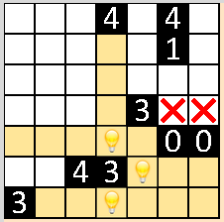
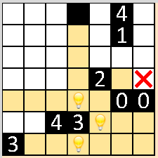
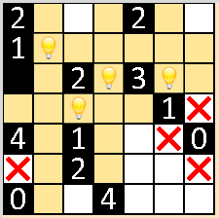
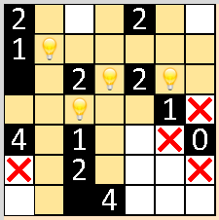
CNN – Initialization Results
5000 randomly generated boards (1 day)
Train Set: 4000
Test Set: 1000
Errors:
Errors similar to FCNN
Not enough training data
Not able to capture a general relationship for initialization
Improvements & Future Work:
Gather more data
Currently gathering data for the complete Hill Climb Solution
Original
Predicted
Original
Predicted

Slide 17
Next Steps
While we are proud of the work we have done here, there is no doubt that more work (particularly, exploration of different algorithms) could yield even better results.
We strongly believe that the Light Up puzzle is an excellent logic puzzle for introducing newcomers to the field of AI to some of the more advanced algorithms available to them.

